Slide 1

Operating Systems Design​ Session 3 : OS Interface
19CS2106R​
© 2020 KL University

Slide 2
Operating System User Interface

Slide 3
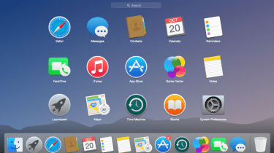
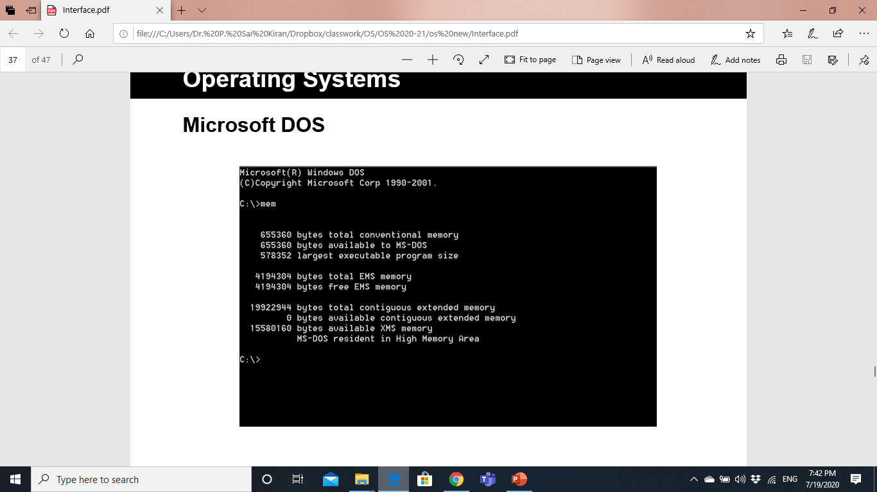
Operating System User Interface
A program that controls a display for the user (usually on a computer monitor) and that allows the user to interact with the system) .
The user interface allows the user to communicate with the operating system.
Types of User Interface
Command line interface
Graphical user interface

Slide 4
Comparison
Ease of Use/Learning
Control on File System/Operating System
Multitasking
Speed of Operating

Slide 5
Operating System Hardware Interface

Slide 6
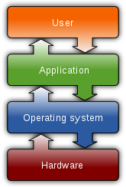
Abstracting physical resources
A key requirement for an operating system is to support several activities at once.
An operating system must fulﬁl three requirements:
Multiplexing
Isolation
Interaction.
Operating System does this through Virtualization
Virtualization refers to process involved in converting a physical view to a logical view.
The logical view is the view of the application programmer.
The physical view refers to the actual physical state of affairs.

Slide 7
Virtualization Mechanisms
There are two general mechanisms for giving the appearance of multiple instances of a resource where there is physically only one resource.
Time-Shared Resources
Processors, mice, keyboards, printers and network connections are time shared between processes.
Partitioned Resources
Memory, displays, and disks are partitioned resources.
These resources are partitioned into "pieces" that are assigned to individual processes.

Slide 8
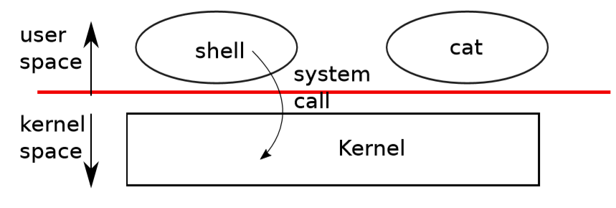
User mode, Kernel mode and System calls
Strong isolation requires a hard boundary between applications and the operating system.
An application can execute only user-mode instructions (e.g., adding numbers, etc.) and is said to be running in user space, .
The software in kernel mode can also execute privileged instructions and is said to be running in kernel space.
The software running in kernel space (or in kernel mode) is called the kernel.
When a process needs to invoke a kernel service, it invokes a procedure call (system call) in the operating system interface.

Slide 9
Process Management
A process is the execution of a program.
The kernel identifies each process by its process number, called the process ID (PID).
A process has Instructions, data and stack in User space.
The instructions implement the program’s computation.
The data are the variables on which the computation acts.
The stack organizes the program’s procedure calls.
Kernel stores the State of every process in Kernel space.

Slide 10
XV6 Interface Design Concepts

Slide 11
XV6 Interface
Shell is the primary user interface to traditional Unix-like systems including XV6.
The shell is an ordinary program(user level) that reads commands from the user and executes them.
The xv6 shell is a simple implementation of the essence of the Unix Bourne shell.
XV6 Kernel
Process Management
I/O Management
File System Management

Slide 12
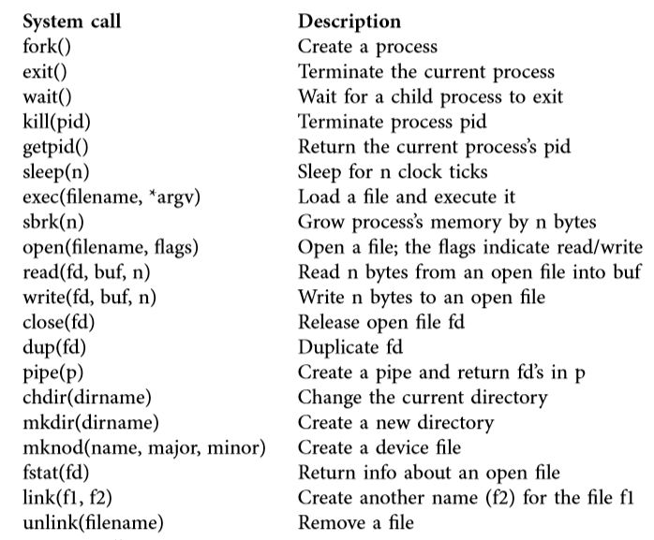
XV6 System Calls

Slide 13
Processes and memory
fork() – Creating a Process
A process on a UNIX system is the entity that is created by the fork system call.
Fork creates a new process, called the child process, with exactly the same memory contents as the calling process, called the parent process.
Every process except process 0 is created when another process executes the fork system call.
Process 0 is a special process that is created "by hand" when the system boots; after forking a child process (process 1), process 0 becomes the swapper process.
Process 1, known as init is the ancestor of every other process.

Slide 14
Processes and memory
fork() – Creating a Process
fork() is used to create processes. It takes no arguments and returns a process ID
The purpose of fork() is to create a new process, which becomes the child process of the caller.
After a new child process is created, both processes will execute the next instruction following the fork() system call.
If fork() returns a negative value, the creation of a child process was unsuccessful.
fork() returns a zero to the newly created child process.
fork() returns a positive value, the process ID of the child process, to the parent.

Slide 15
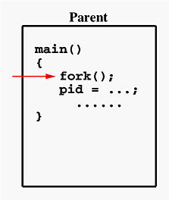
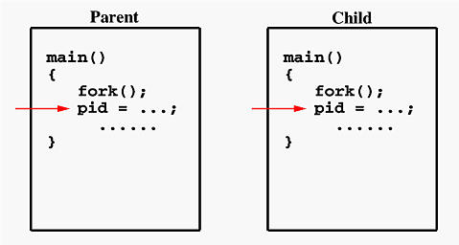
Processes and memory
fork() – Creating a Process
The fork() System Call
24667
24668
pid =24668
pid =0

Slide 16
Processes and memory
Wait() and exit()
The system call wait() blocks the calling process until one of its child processes exits or a signal is received.
The exit system call causes the calling process to stop executing and to release resources such as memory and open ﬁles.
Exit takes an integer status argument, conventionally 0 to indicate success and 1 to indicate failure.

Slide 17
Processes and memory
fork(), wait() and exit() usage example
int pid = fork();
if(pid > 0){
printf("parent: child=%d\n", pid);
pid = wait();
printf("child %d is done\n", pid);
} else if(pid == 0){
printf("child: exiting\n");
exit();
} else {
printf("fork error\n");
}
parent: child=1234
child: exiting
parent: child 1234 is done

Slide 18
exec()
Processes and memory
The exec system call replaces the calling process’s memory with a new memory image loaded from a ﬁle stored in the ﬁle system.
The created child process does not have to run the same program as the parent process does.
fork starts a new process which is a copy of the one that calls it, while exec replaces the current process image with another (different) one.
Both parent and child processes are executed simultaneously in case of fork() while Control never returns to the original program unless there is an exec() error.

Slide 19
I/O and File descriptors
A file descriptor is a small integer representing a kernel-managed object that a process may read from or write to.
A file descriptor interface abstracts away the differences between files, pipes, and devices, making them all look like streams of bytes.
The read and write system calls read bytes from and write bytes to open files named by file descriptors.
The call read(fd, buf, n) reads at most n bytes from the file descriptor fd, copies them into buf, and returns the number of bytes read.
The call write(fd, buf, n) writes n bytes from buf to the file descriptor fd and returns the number of bytes written.
The close system call releases a file descriptor, making it free.

Slide 20
Pipes
A pipe is a small kernel buffer exposed to processes as a pair of file descriptors, one for reading and one for writing.
Writing data to one end of the pipe makes that data available for reading from the other end of the pipe.
Pipes provide a way for processes to communicate

Slide 21
File System
The xv6 file system provides data files, which are uninterpreted byte arrays, and directories, which contain named references to data files and other directories.
The directories form a tree, starting at a special directory called the root.
Paths that don’t begin with / are evaluated relative to the calling process’s current directory, which can be changed with the chdir system call.
There are multiple system calls to create a new file or directory: mkdir creates a new directory, open with the O_CREATE flag creates a new data file, and mknod creates a new device file.

